Slide 1
Meta Kaggle and Trends in Data Science and Machine Learning
Presented By:
Pranay Reddy Gundala
Geetika Elaprolu
Niteesha Jangam
Rasaghna Kuturu
Yamine Ane

Slide 2
Hello!
We are Pranay, Rasaghna, Geetika, Niteesha, and Yamini.

Slide 3
Table of contents
02
03
04
01
05
06
Introduction
Related Work
Datasets
Project Plans
07
08
Results
Conclusion
Exploratory Data Analysis
Data Visualization

Slide 4
01
Introduction

Slide 5
Introduction
AIM
The main goal of this visualization project is to illustrate the evolution of competition participation and increasing trends of Machine Learning and Data Science on Kaggle over the past decade. We also aim to understand the changing team dynamics, the impact of prizes on participation, temporal trends in solution approaches, and the popular libraries, and packages used for the competitions and look at how the leaderboards change.
IMPORTANCE
This project is important because it helps us understand how Kaggle competitions and trends in data science and machine learning have changed over the years. By using data visualization, we can easily see patterns and insights from the Meta Kaggle datasets. This information can help the organizers understand the effectiveness of these Kaggle competitions. Understanding these trends can improve competition designs, provide scope for innovation, and support the growth of the data science community.

Slide 6
02
Related Work

Slide 7
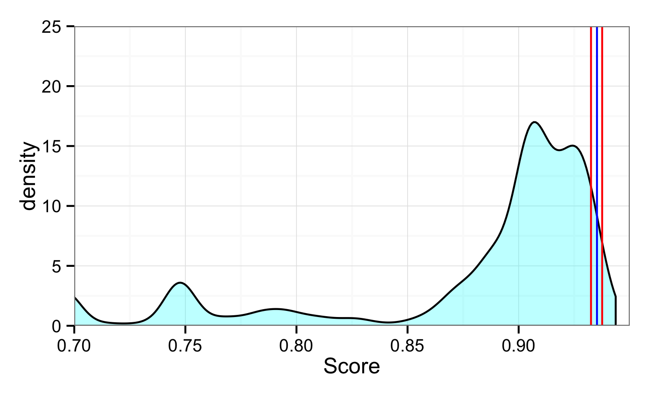
Related Work
Upon doing an extensive literature survey, here are a few existing approaches that were identified:
.
This graph represents a kernel density estimate (KDE) plot with a possible relationship to the Kaggle competition score distribution.

Slide 8
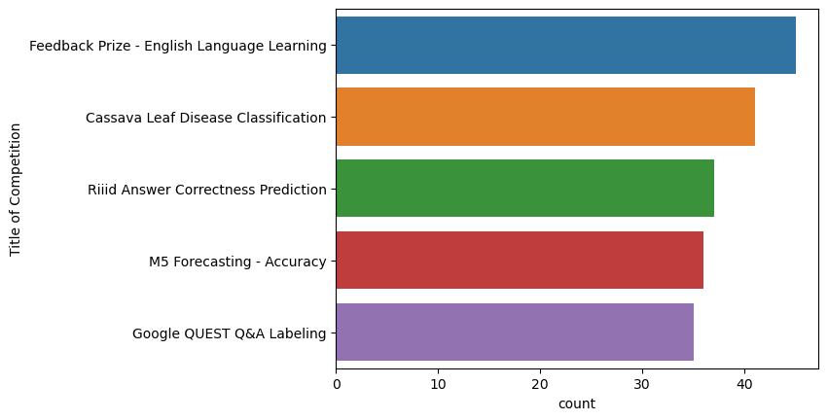
Related Work
This visualization shows the quantity of submissions or participants in various Kaggle competitions.

Slide 9
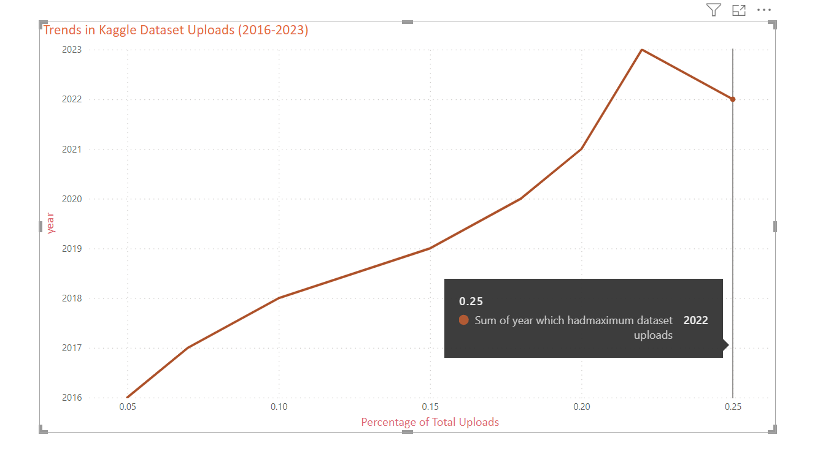
Related Work
Trends in Kaggle Dataset Uploads (2016-2023), traces the percentage of dataset uploads to the Kaggle platform over several years.

Slide 10
03
Datasets

Slide 11
Datasets
Dataset | Description | Statistics of the dataset | Attributes of Interest
Competitions.csv | Each row shows data about competitions held. | 42 attributes | total competitors, total submissions, total teams, number of prizes in a competition, and start date of the competition
Datasets.csv | This file contains a table of metadata about datasets on Kaggle. Each row in the table represents a single dataset. There are a total of 14 attributes which include data about the current dataset version, data source, total votes for a dataset, total views, etc. | 14 attributes | Dataset domain, source
Submissions.csv | This dataset contains information about the submissions made to the competitions. | 11 attributes and around 13M rows | TeamId, Score, IsAfterDeadline, LeaderBoard Ranking
Organizations.csv | The dataset corresponds to the information about various organizations arranging the Kaggle competitions. | 5 columns and 787 rows | name of the organizer and competition description

Slide 12
04
Project Plans

Slide 13
Project Plans
Project Initiation and Requirement Gathering
Data Collection and Preparation
Exploratory Data Analysis (EDA)
Data Visualization and Analysis
(Gather and prepare the required datasets for analysis)
Acquire the Competitions.csv, Datasets.csv, Submissions.csv, and Organizations.csv datasets.
Perform initial data cleaning and formatting to ensure data quality.
(Explore the data to understand the underlying patterns and trends)
Perform statistical analysis to summarize the data's main characteristics.
Identify and handle any missing data or outliers.
Merge tables and establish connections between different datasets.
(Create visual representations of the data to answer the research questions)
Develop visualizations such as timelines of participation, evaluation algorithms, and total competitors vs. total teams.
Interpret the results of the visualizations and extract insights.
Prepare preliminary findings to present to the client for feedback.
(Define the project's scope, goals, and objectives based on the client's needs
Initial meetings with the client to discuss the project's importance and aim.
Identify the key questions the client wants to answer through this project.
Document the requirements
Deciding the tools
Client Reporting
(Communicate the findings and insights to the client effectively)
Compile the final report with all visualizations and insights.
Create a comprehensive presentation, including sections on motivation, related work, and datasets.
Present the final insights and recommendations to the client and discuss potential impacts and next steps.

Slide 14
05
Exploratory Data Analysis

Slide 15
Merged tables and establish connections
Remove unnecessary Columns & De-duplication of data
Data Cleaning
Data Formatting (True-1, False-0)
Numeric and Text Processing

Slide 16
06
Data Visualization

Slide 17

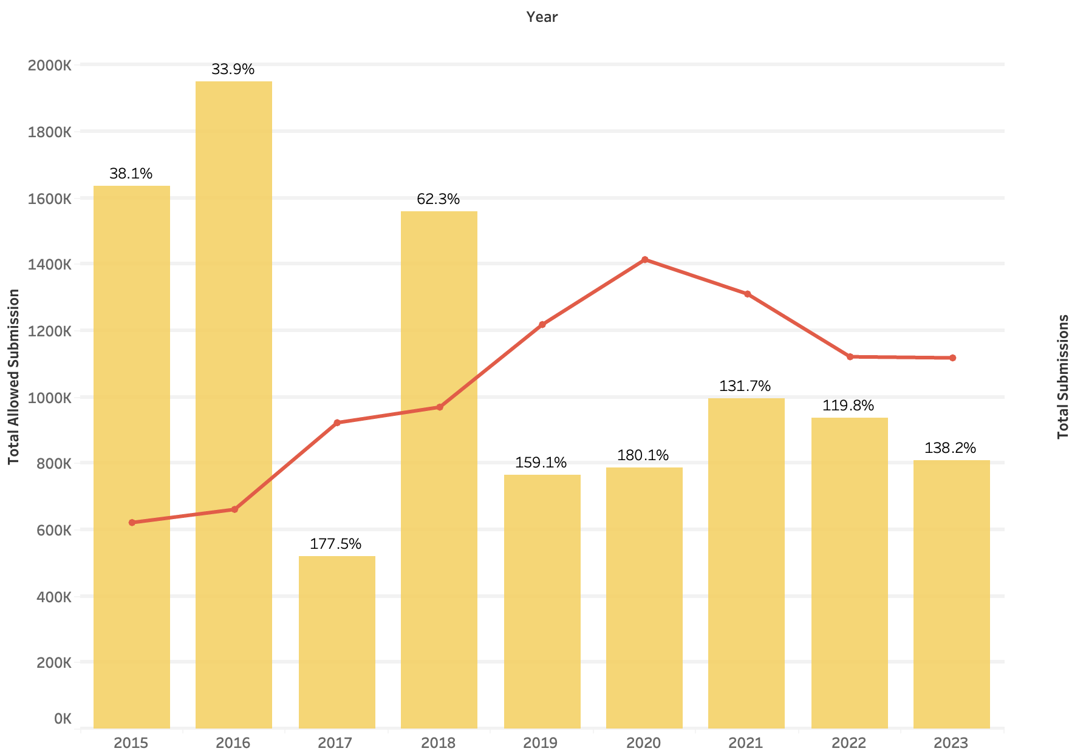
How did the participation efficiency of competitions change over the past decade?

Slide 18
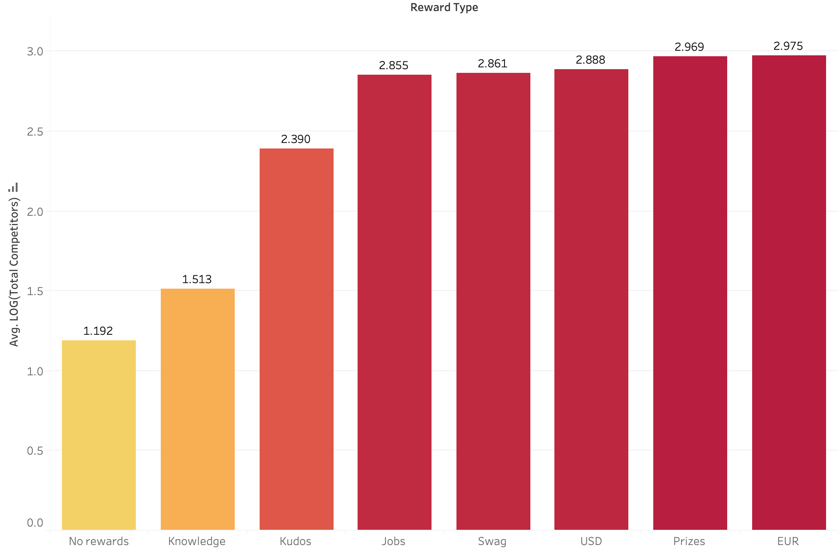
Does the reward given out affect the participation efficiency?
.
j
Variation in log of total competitors based on the rewards offered.

Slide 19
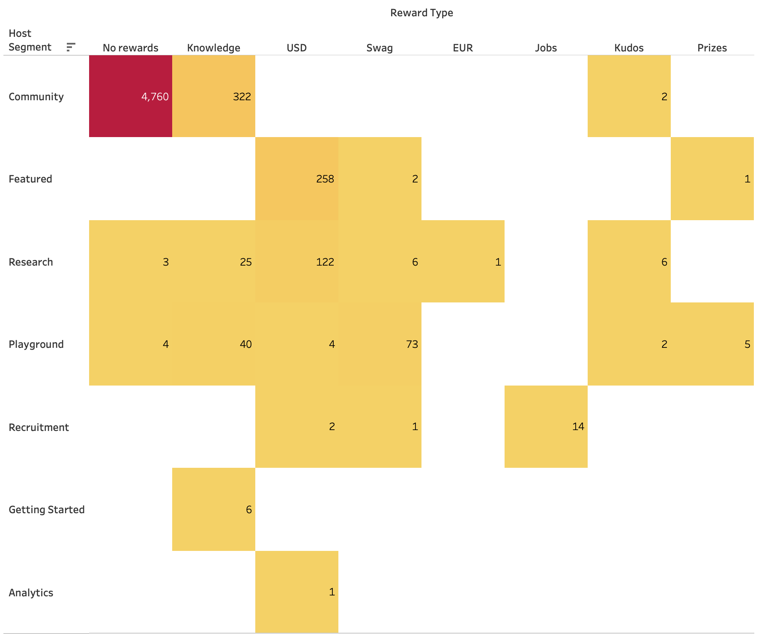
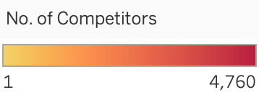
How do the rewards offered vary across different types of competition?
Crosstab showing change in participation according to the competition segment and rewards offered.

Slide 20
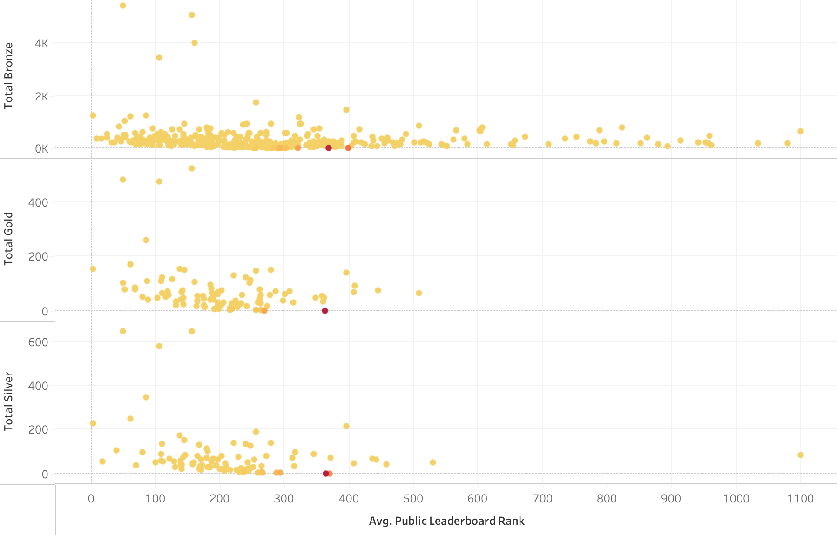
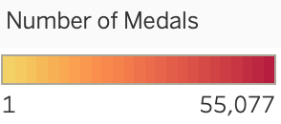
How does the participants’ achievements impact the entire team performance?
Change in the Average Public Leaderboard Ranking of Teams with the team member’s achievement.

Slide 21
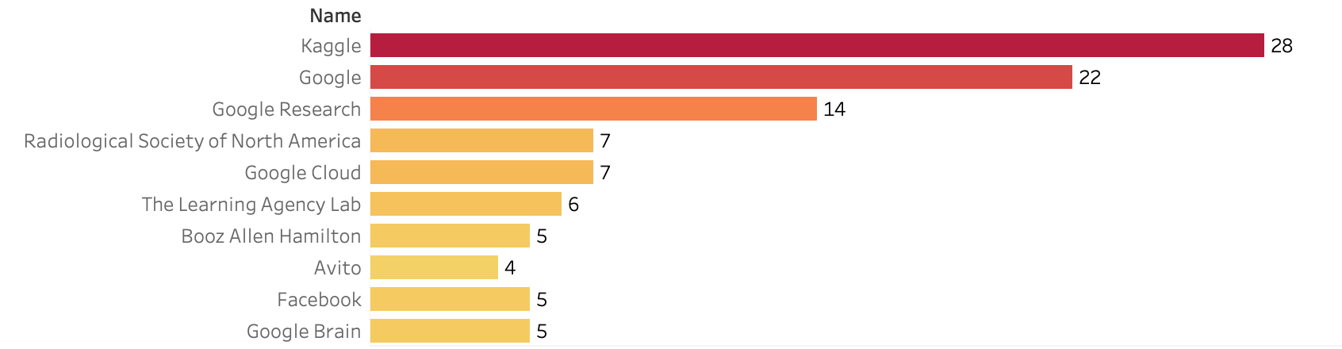
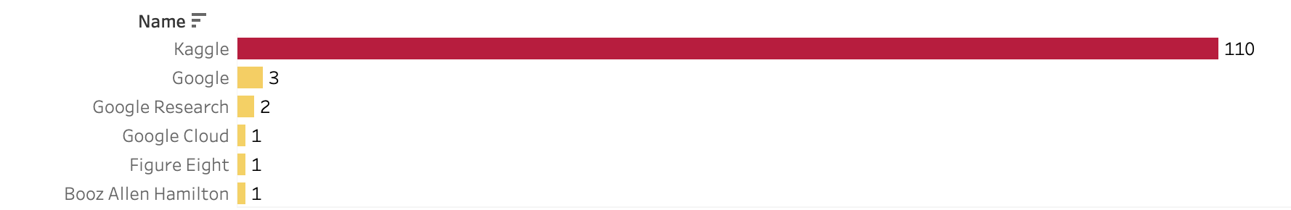
Which organizations have held the most competitions on Kaggle?
Organizations which have held the most number of competitions in professional category (having competition type as Research, Recruitment, Featured, Analytics).
Organizations which have held the most number of competitions in Entry-level category (having competition type Playground, Getting Started, Community).

Slide 22
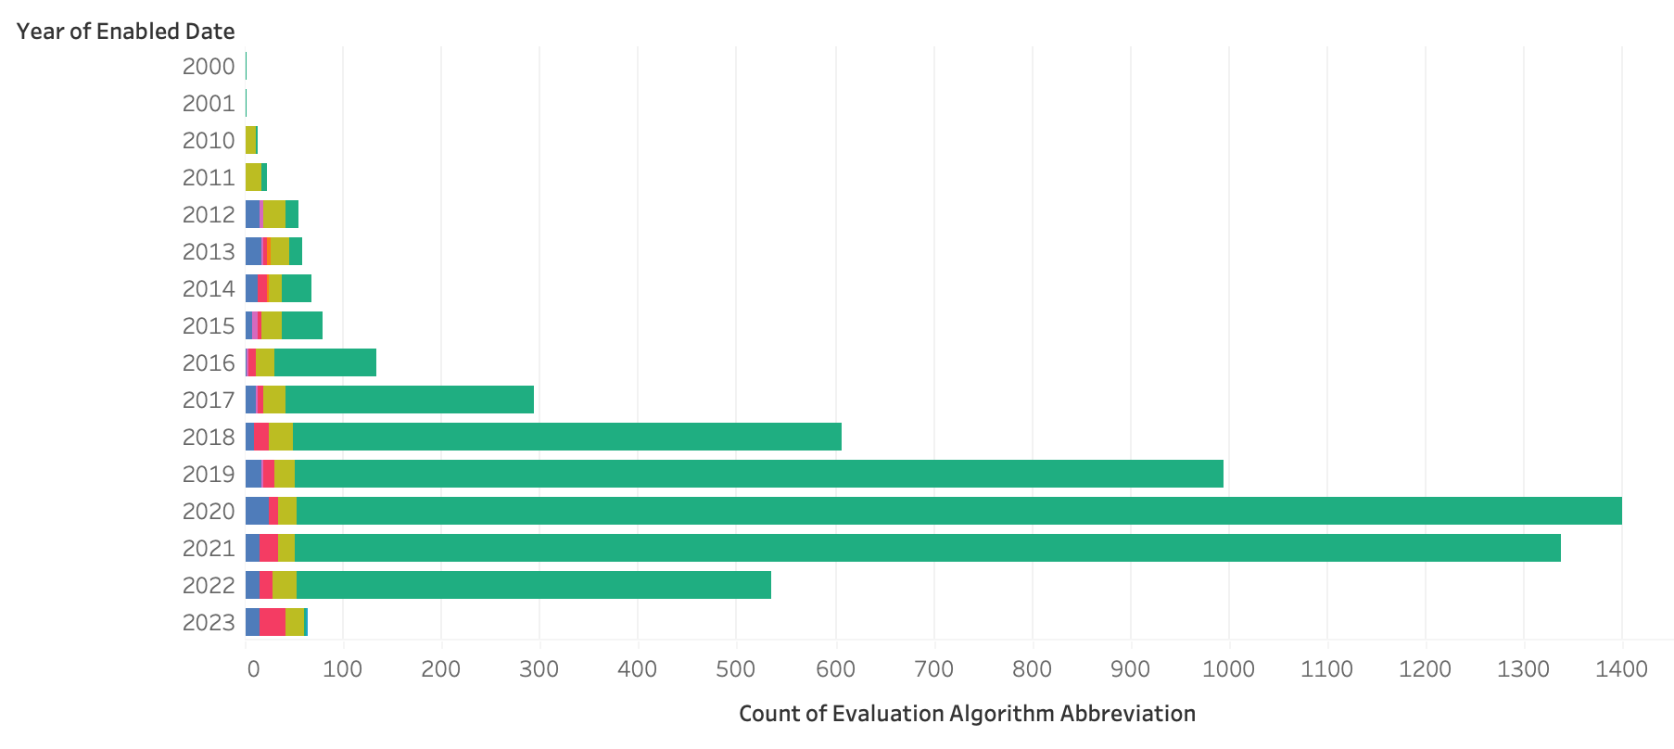
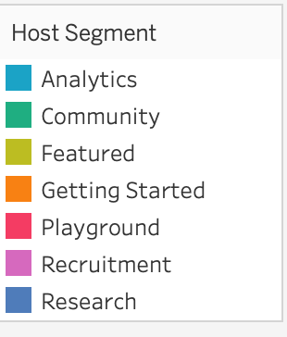
How did different evaluation algorithms come into existence over time and which type of Kaggle competitions have seen the most growth of these algorithms?
Usage of evaluation algorithms per year by host segment.

Slide 23
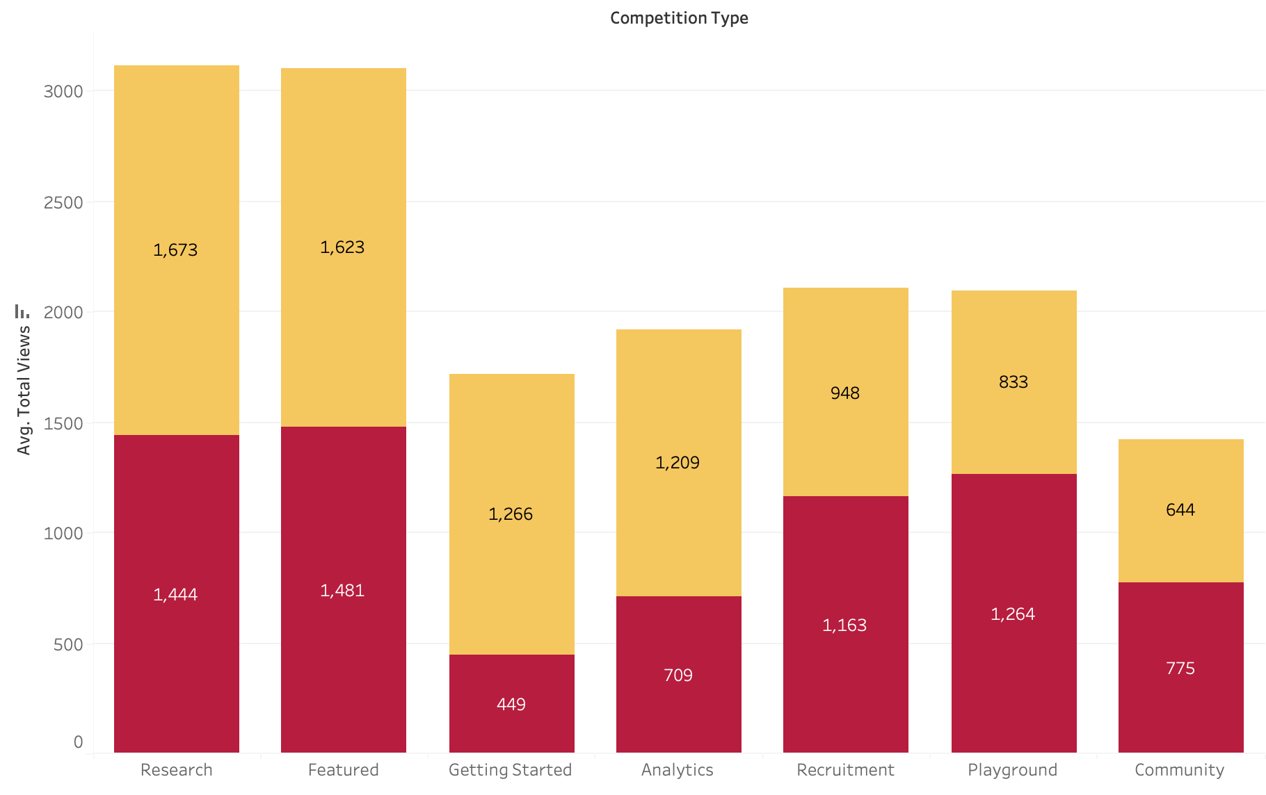
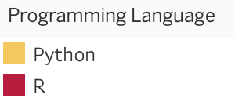
How does the popularity of programming languages vary across different competition types on Kaggle?
Average views of kernels across various competition types.

Slide 24
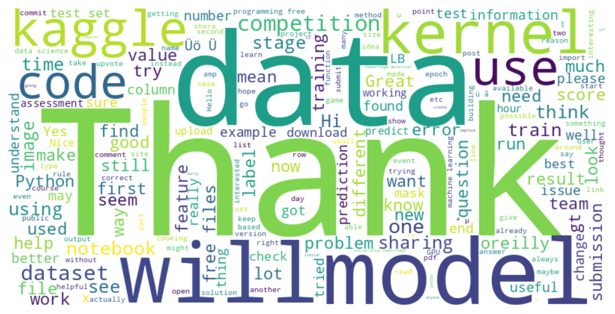
How do the distributions of Polarity and Subjectivity scores across messages influence the overall sentiment and subjectivity perception in online communities or forums?
Word Cloud Analysis of Collaboration in Online Forum Conversations.

Slide 25
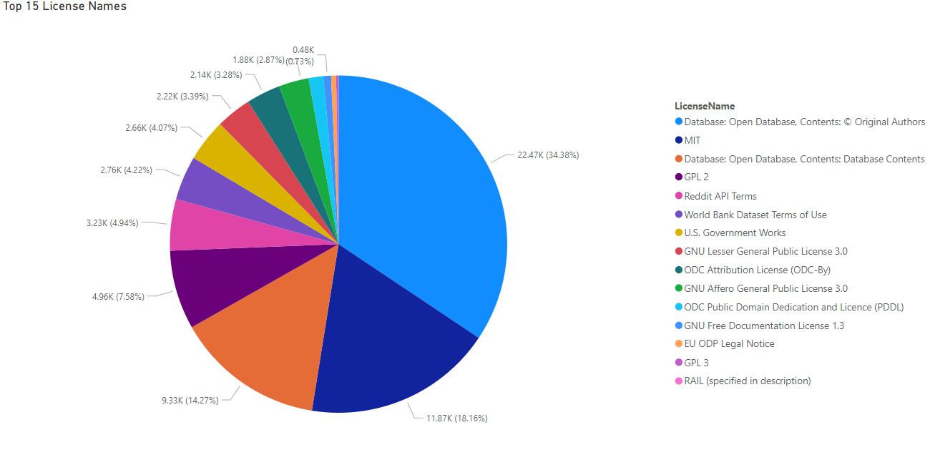
What are the top Licenses used by participants?

Slide 26
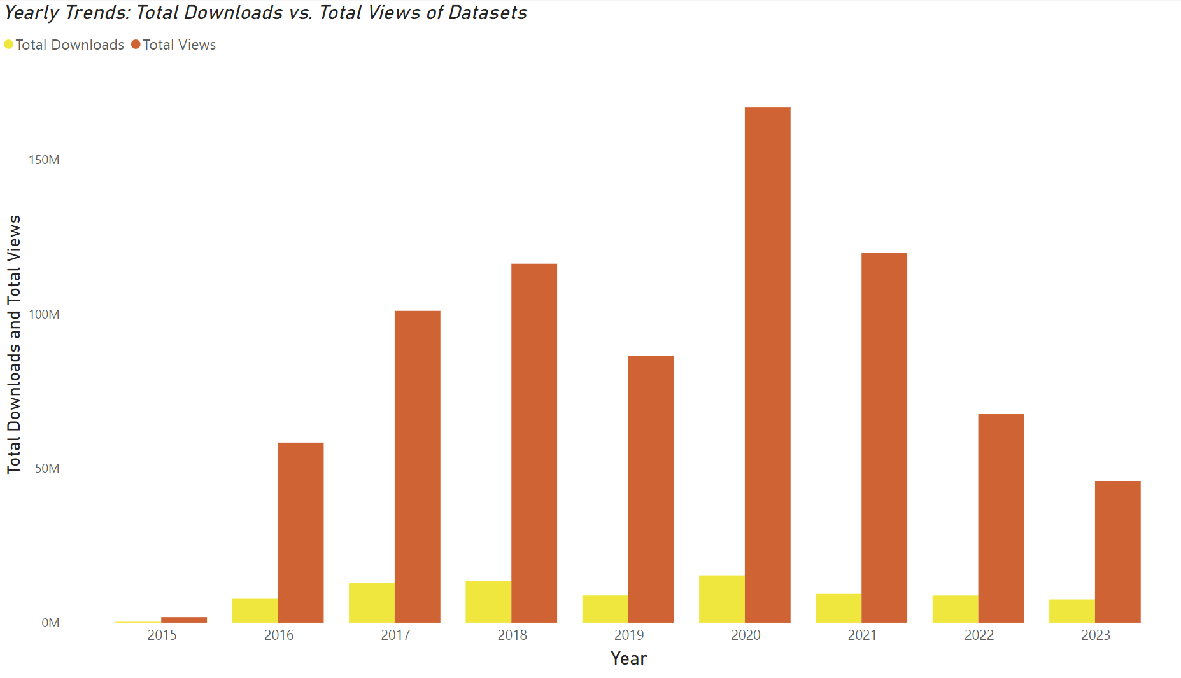
How does the level of engagement with datasets vary across different years?
Total downloads vs. total views of datasets.

Slide 27
Results
Individual scripting skills significantly impact team performance on Kaggle, with top achievers lifting team standings.
Skilled leaders play a crucial role in improving team rankings, as even a few high-performing individuals can greatly influence overall performance.
Featured competitions on Kaggle show a concentration in the adoption of evaluation algorithms over the years, highlighting the necessity for precise performance metrics.
The evolving landscape of evaluation algorithms underscores the need for competitors to stay updated with the latest trends to enhance their leaderboard scores.
Insights from data analysis emphasize the importance of both individual excellence and strategic leadership for success in Kaggle competitions.

Slide 28
Conclusion
The project comprehensively charts the evolution and current state of Kaggle competitions, offering insights into participation trends, technological adoption, and factors contributing to team success.
A decrease in participation efficiency since 2019 is highlighted, suggesting changes in competition formats and shifting participant priorities as possible causes.
Despite this decline, continued engagement in competitions with substantial cash rewards underscores the motivational impact of financial incentives.
The utilization of more robust evaluation algorithms in Featured competitions reflects the growing complexity and stakes in data science contests, providing actionable insights for shaping future competition designs and fostering a thriving data science community.

Slide 29
Thank You!

